Slide 1
Chat – Web Application

Slide 2

Chat – Web Application
Presented By : Solanki Rushabh Pareshbhai ,
Sheth Parth Alpeshbhai
Enrollment No. : 23084221028 ,
23084221034
Group No. : 3
Course : MSC.IT
Semester : III
Subject Code & Subject Name : P43A4PRD & Project Dissertation
Guided By : Dr. Bharat Prajapati
Internal Guide Name : Proffercer. Sonal Patel
Submitted To : Department of Computer Science, GANPAT UNIVERSITY

Slide 3
INDEX
Project Profile & Objectives
Requirement Specification (Existing System)
Need for the New System
Minimum Hardware Requirement
Minimum Software Requirement
Function Specification
System Flow Chart
ER Diagram
UML Diagram
Data Dictionary

Slide 4
Project Profile & Objectives
No. | Title | Description
1 | Project Title | Chat – Web Application
2 | Objective | Here's an enhanced outline and attractive content for our Project Chat – Web Application, which works like Google Messenger, focusing on real-time chat and user presence status (online/offline) and also that user send and receive messages, photos, videos, Files also that is download it.
3 | Front – End Tools | React JS(18.3.1)
4 | Back – End Tools | Node JS(20.15.1) with Express Framework
5 | Technology | Java Script (.js), Type Script (.ts)
6 | Database | MongoDB, Firebase
7 | Internal Guide Name | Proffercer Sonal Patel
8 | Prepared By | Rushabh Solanki

Slide 5
Requirement Specification (Existing System)
Limited support for large file.
Some files are not send to other chat – Web Application.
Some real time chat data is not secured in market in this time and Some time this Data is Crashed and Your Important Data to miss it.
Some chat – Web Application is called real time chat app but app is the not proper work on this real time chating.

Slide 6
Need for the New System
Data Storage : This Chat – Web Application throw user data store in MongoDB and chat data store in firebase , that throw both are database and technology to learn tham and implement.
Development : This Chat – Web Application Development in Redux Saga throw fully development to create and develop this Chat – Web Application.
Easy to Access : This Chat – Web Application is only you can Registered mobile number and password throw login and access any time you create a real time chat.

Slide 7
Minimum Hardware Requirement
Server Configuration :-
➔Processor : core i3 or Higher any other
➔Ram : 4GB or more than
➔Hard Disk : 100GB or more than
Client Configuration :-
➔Processor : core i3 or Higher any other
➔Ram : 4GB or more than

Slide 8
Minimum Software Requirement
Server Configuration :-
➔Front – End : React JS(18.3.1)
➔Back – End : Node JS (20.15.1) with Express Framework
➔Technology : JavaScript (.js) and TypeScript (.ts)
➔Database : MongoDB, Firebase
➔Operating System : Windows 10
Client Configuration :-
➔Operating System : Windows 10 or more then
➔Browser : Google Chrome or any other browser

Slide 9
Function Specification
USER :-
➔Manager Profile
➔Registered All Users to Chat Built tham
➔Proper User to Photo, Video and File to send tham properly with out any permises.
➔Receiver User that Photo, Video and File to Download tham
➔Particular User’s Status (Online/Offline) check tham.

Slide 10
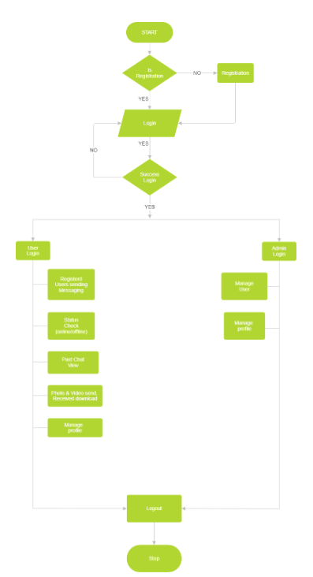
System Flow Chart

Slide 11
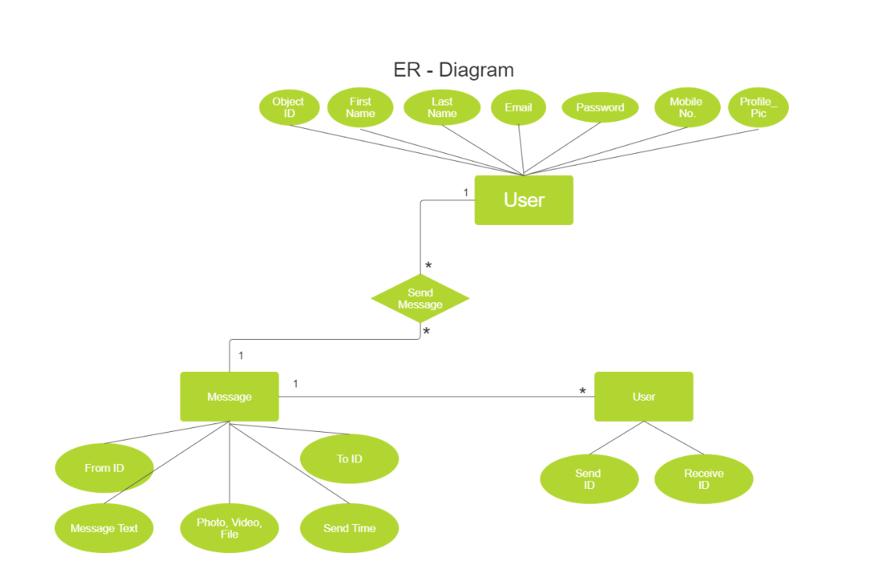
ER - Diagram

Slide 12
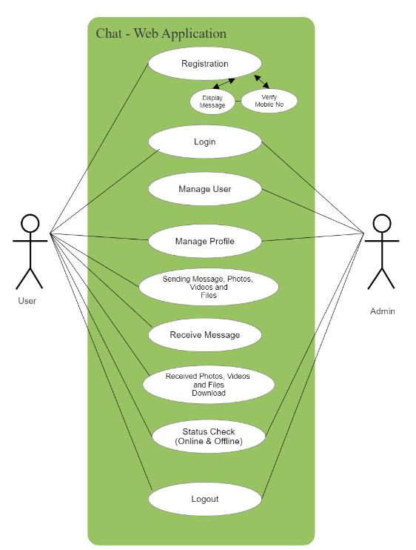
Use Case Diagram

Slide 13
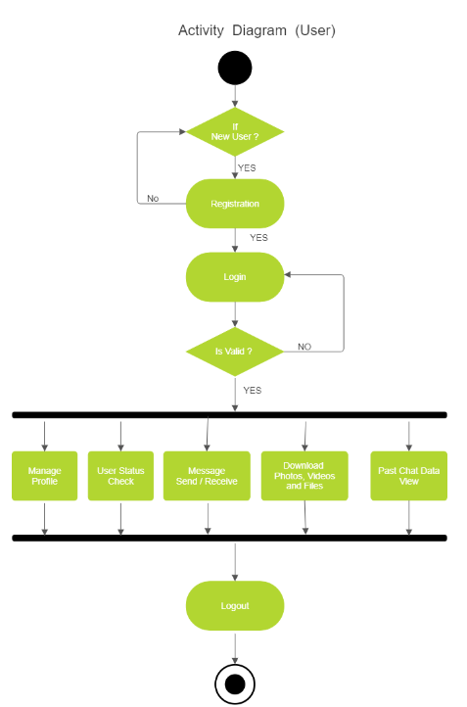
Activity Diagram (User)

Slide 14
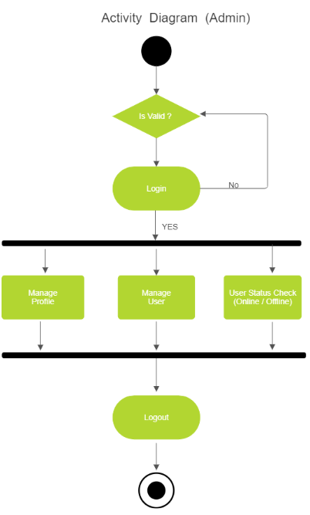
Activity Diagram (Admin)

Slide 15
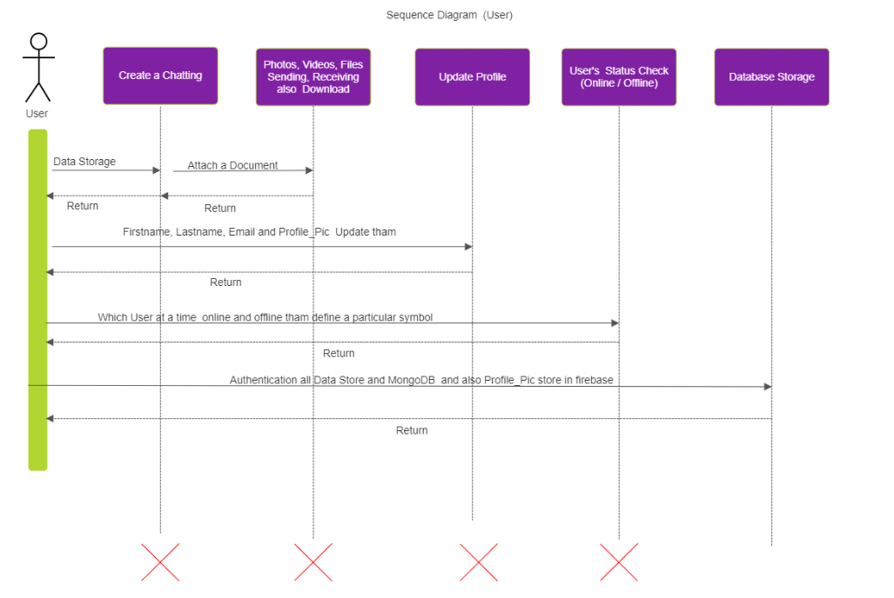
Sequence Diagram (User)

Slide 16
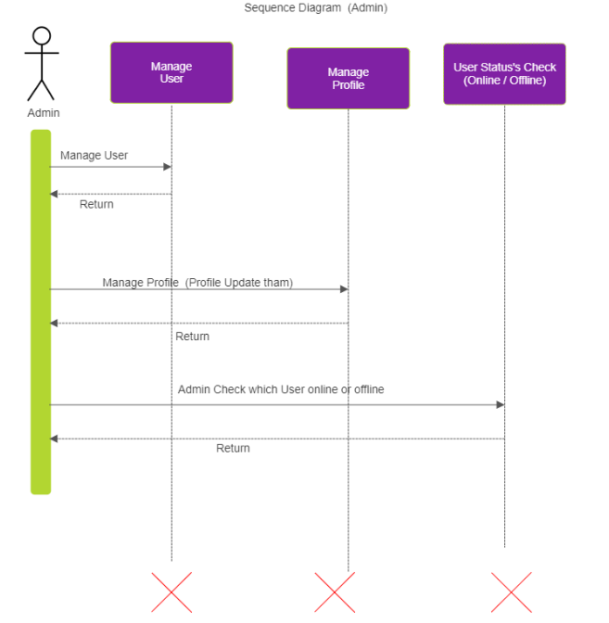
Sequence Diagram (Admin)

Slide 17
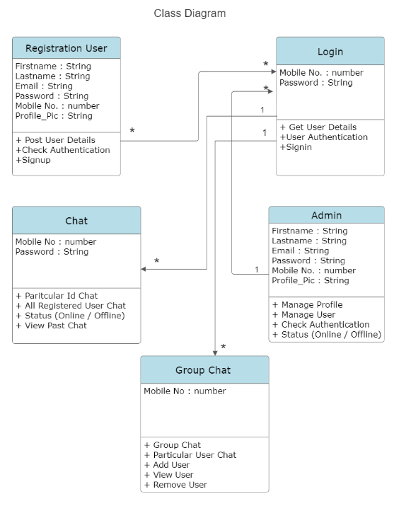
Class Diagram

Slide 18
Data Dictionary (User Table)
Field Name | Datatype | Constraint | Description
Object ID | String | By Default | When Record Insert Then auto applied
First Name | String | Not Null | First Name Display here
Last Name | String | Not Null | Last Name Display here
Email | String | Not Null | Email Display here
Password | String | Not Null | Corrupted Password Display Here
Mobile No. | Number | Not Null (Primary Key) | Mobile No. is Unique.
Profile_Pic | String | Not Null | Profile _Pic file name store

Slide 19
Data Dictionary (Profile_Pic Table)
Field Name | Datatype | Constraint | Description
Filename | String | Should be unique, can be generated based on user ID. | Name of Uploaded File
Filepath | String | Stored in a predefined folder | File Storage path Displayed
Filesize | Number | File Size | Displayed File Size bytes
Filetype | String | File types(.jpg, .jpeg, .png) | Which type file It’s displayed
Upload time | Timestamp | Automatically captured by Firebase. | The timestamp when the file was uploaded to Firebase
Download URL | String | Generated by Firebase, used for displaying the image. | Public URL for accessing the file
User ID | String | Links to the user in your MongoDB. | Unique ID of the user to whom the picture belongs
File ID | String | Auto-generated by Firebase to identify the stored file. | Unique Firebase identifier for the file

Slide 20
Data Dictionary (Chat Table)
Field Name | Datatype | Constraint | Description
Message ID | String | Auto-generated or manually generated. | Unique ID for each message
Sender ID | String | Must map to a valid user in the database. | Unique ID of the user sending the message
Receiver ID | String | Must map to a valid user in the database. | Unique ID of the user receiving the message
Chatroom ID | String | Groups messages between specific users. | Unique identifier for the chat room
Message Content | String | Can be text, emojis, or URLs. | The actual text or content of the message
Media URL | String | Null if no media is attached. | Media URL
Message Send Time | Timestamp | Auto-generated at the time of sending the message. | The time when the message was sent
Status | String | Values(Send, Receive, Read) | Message Status Displayed
IsDeleted | Boolean | By Default, Value is False | When Message to delete that time value true

Slide 21
Thank you

